Slide 1
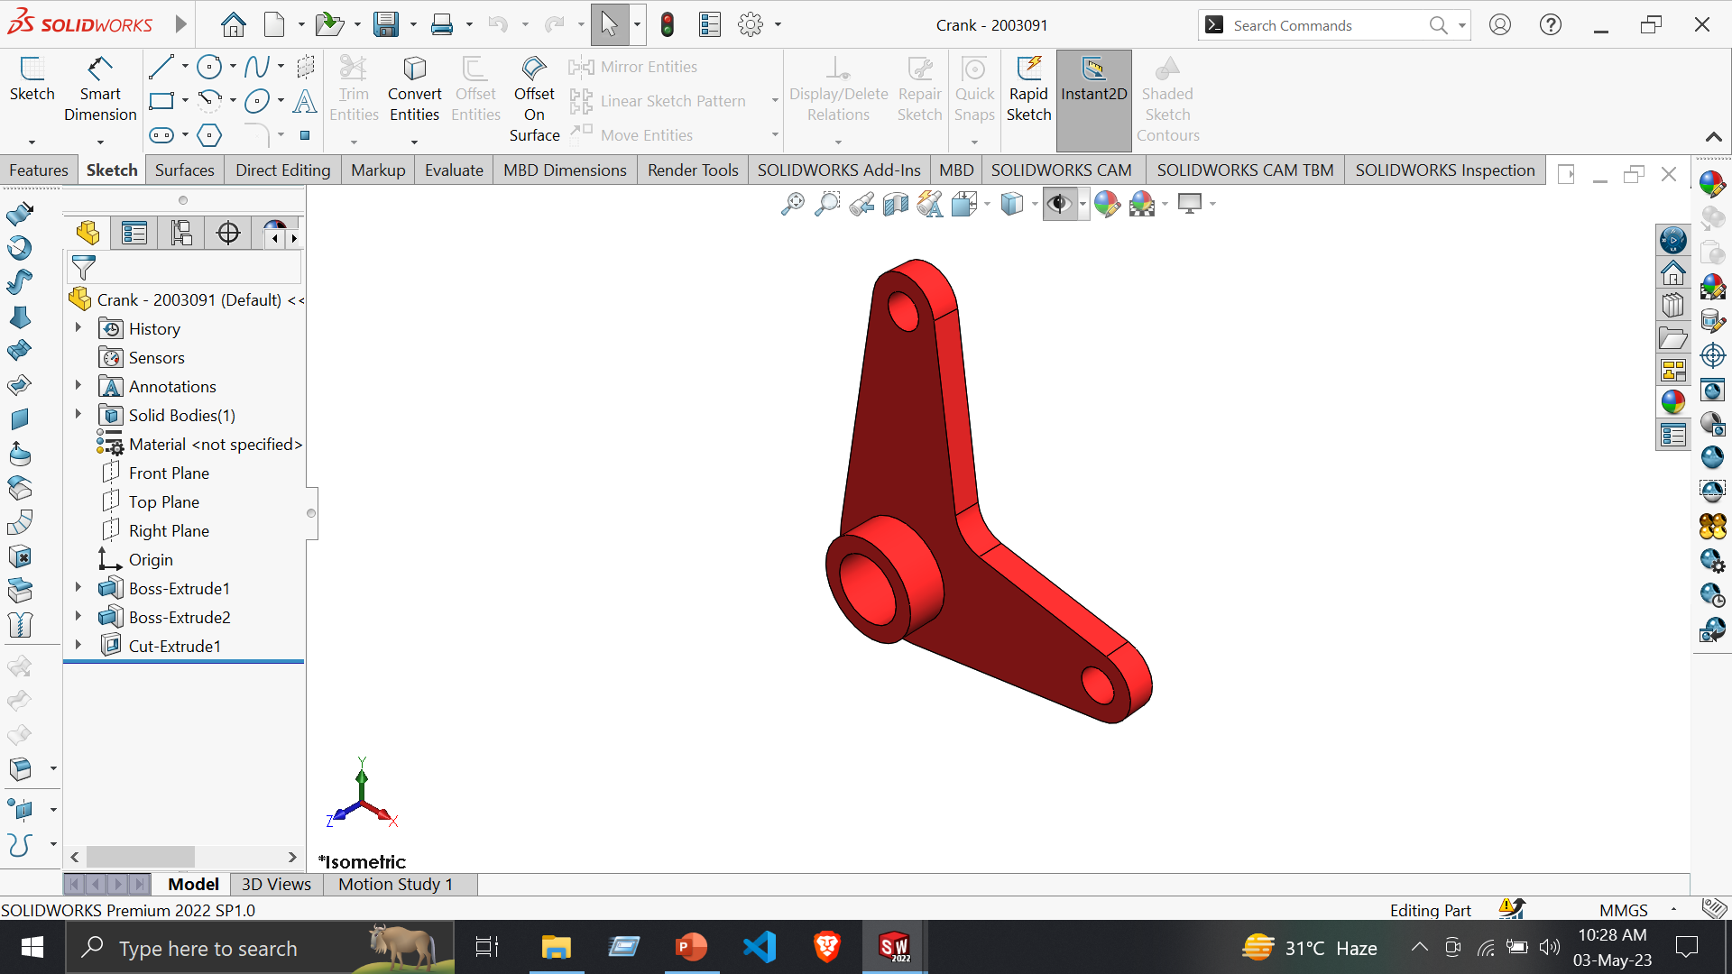
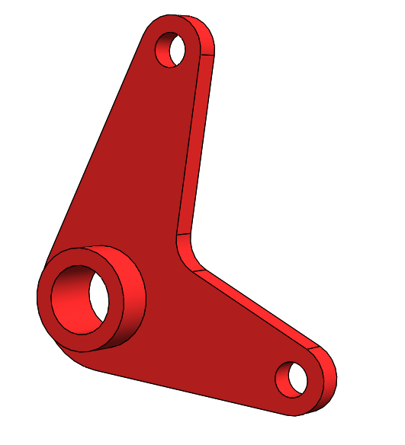
1. Crank
Features:
Extruded Boss/Base
Extruded Cut
Tools:
Line
Corner Rectangle
Smart Dimension
Display/Delete Relations -> Add Relation

Slide 2
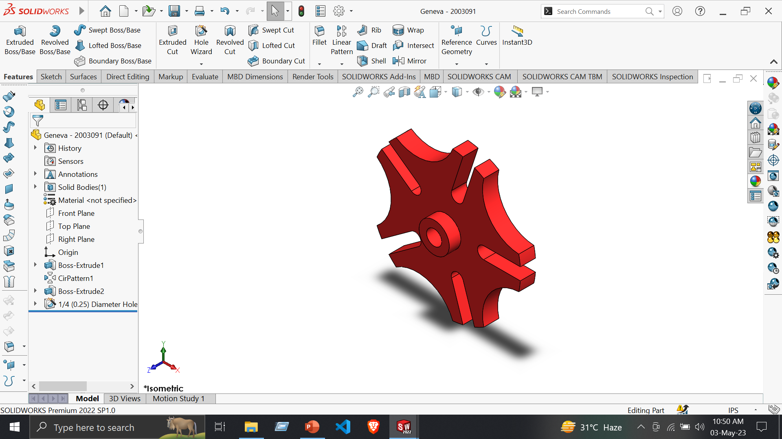
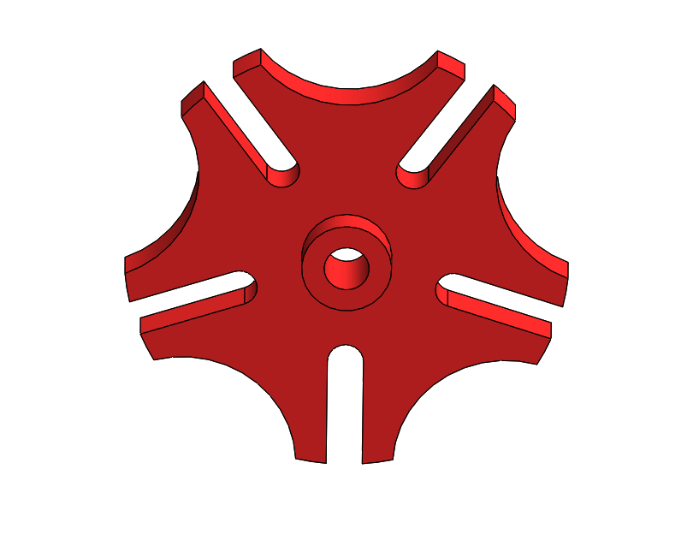
2. Geneva Gear Index
Features:
Extruded Boss/Base
Circular Pattern
Hole Wizard
Tools:
Line
Centrepoint Arc
Circle
Construction Geometry
5. Display/Delete Relations -> Add Relation
6. Trim Entities
7. Smart Dimension

Slide 3
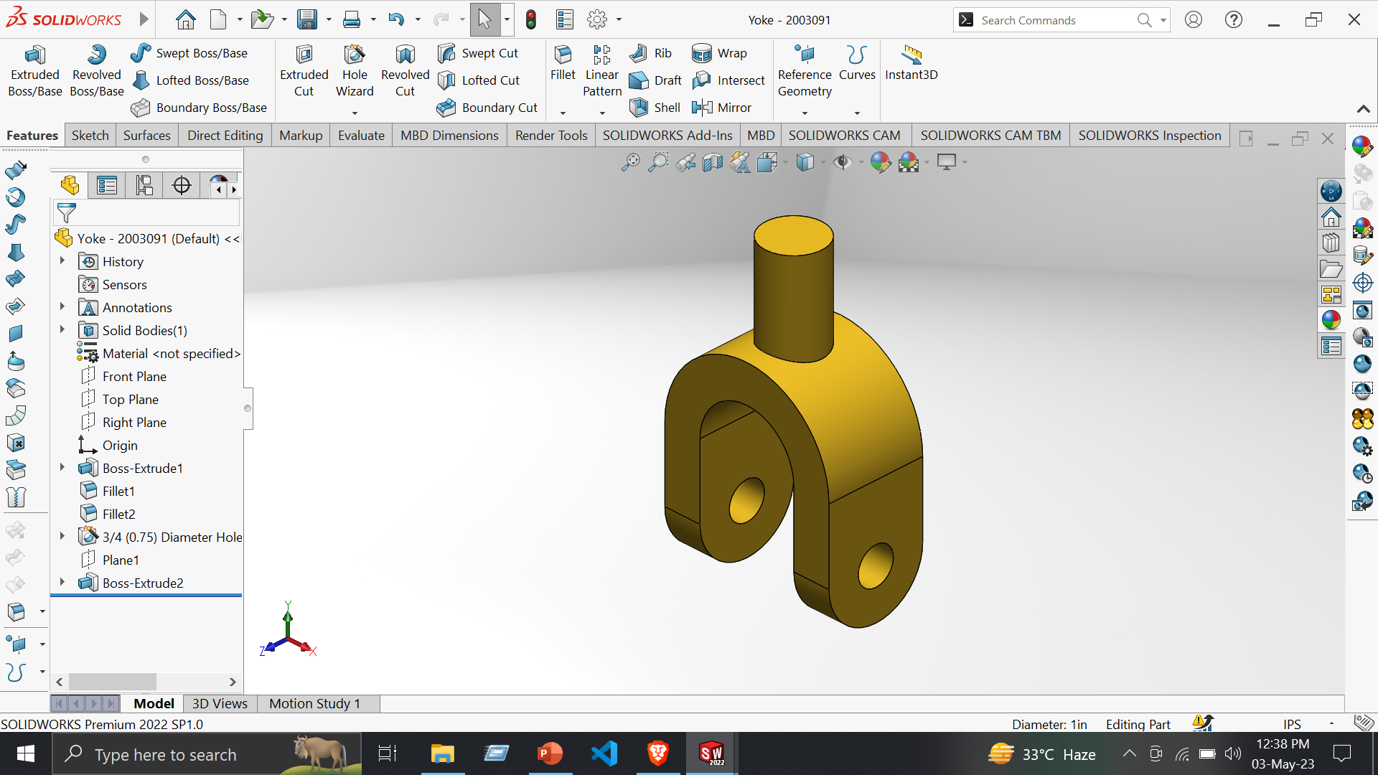
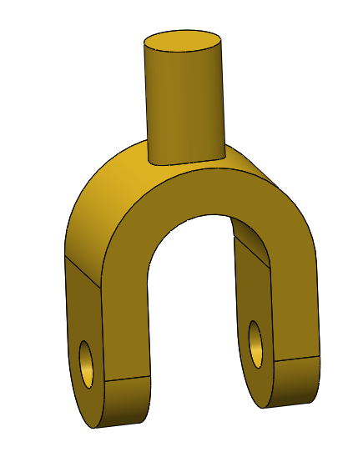
3. Yoke
Features:
Extruded Boss/Base
Fillet
Hole Wizard
Reference Geometry -> Plane
Tools:
Line
Centerline
Circle
Smart Dimension

Slide 4
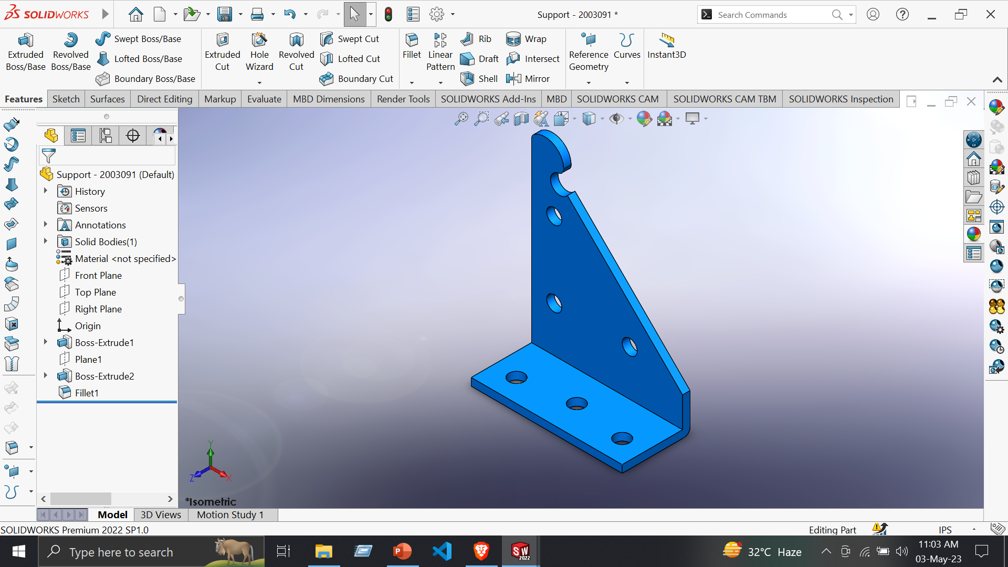
4. Support
Features:
Extruded Boss/Base
Reference Geometry -> Plane
Fillet
Tools:
Line
Circle
Sketch Fillet
Trim Entities
5. Display/Delete Relations -> Add Relation
6. Smart Dimension

Slide 5
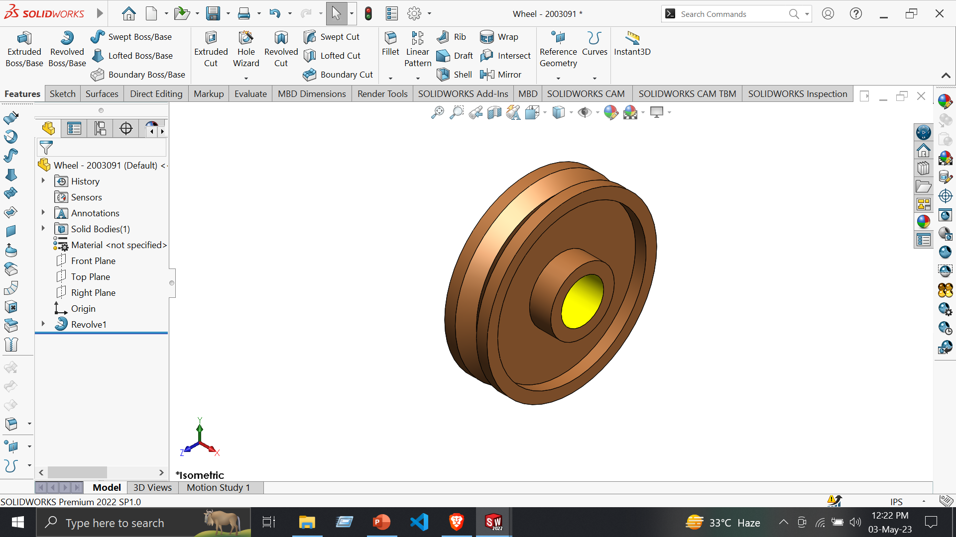
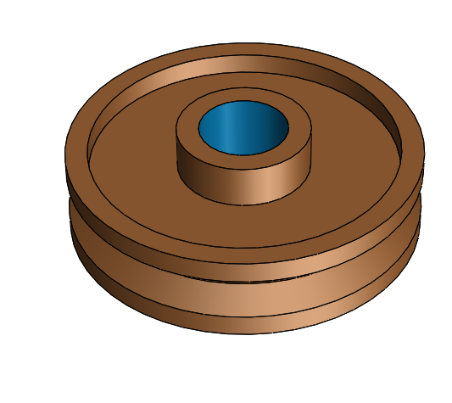
5. Wheel
Features:
Extruded Boss/Base
Revolved Boss/Base
Tools:
Line
Centerline
Circle
Construction Geometry
Smart Dimension

Slide 6
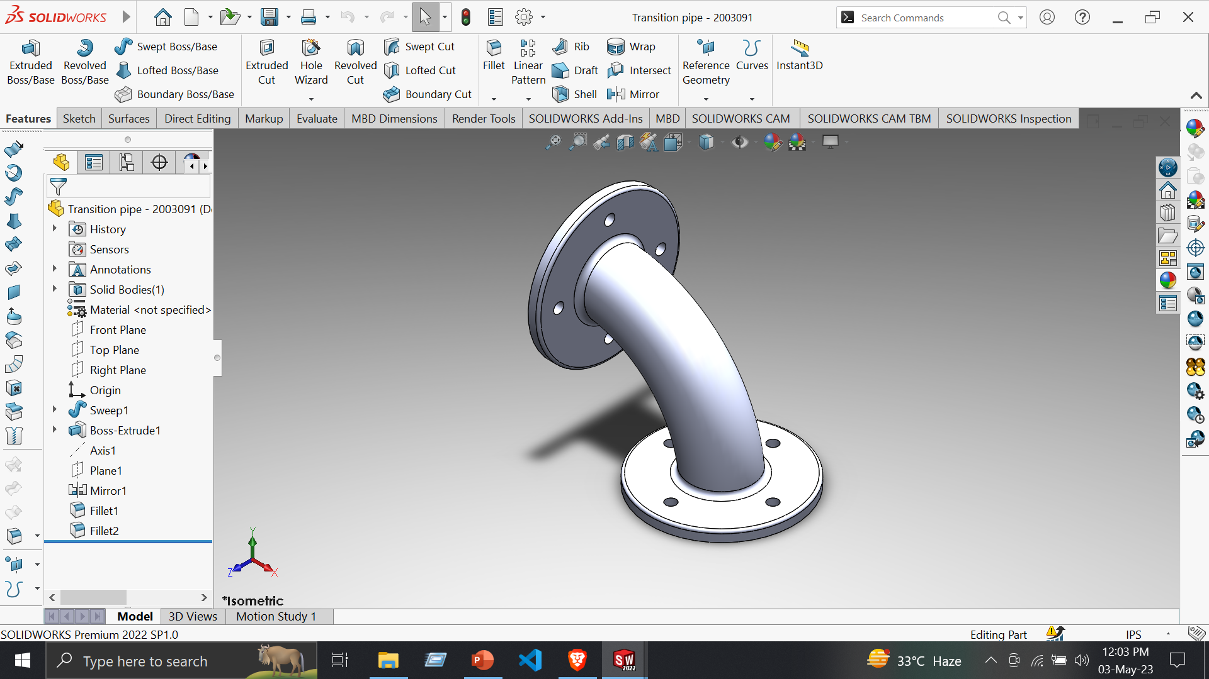
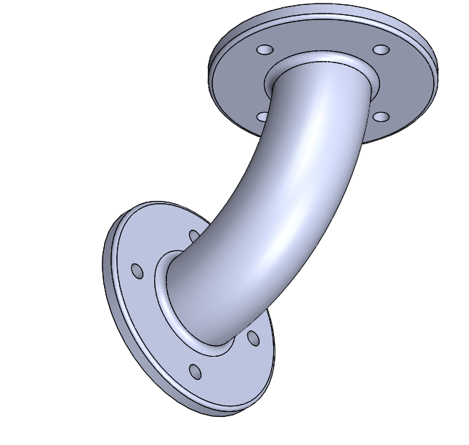
6. Transition Pipe
Features:
Extruded Boss/Base
Revolved Boss/Base
Swept Boss/Base
Reference Geometry -> Plane
Fillet
Tools:
Line
Centerline
Circle
Construction Geometry
Smart Dimension

Slide 7
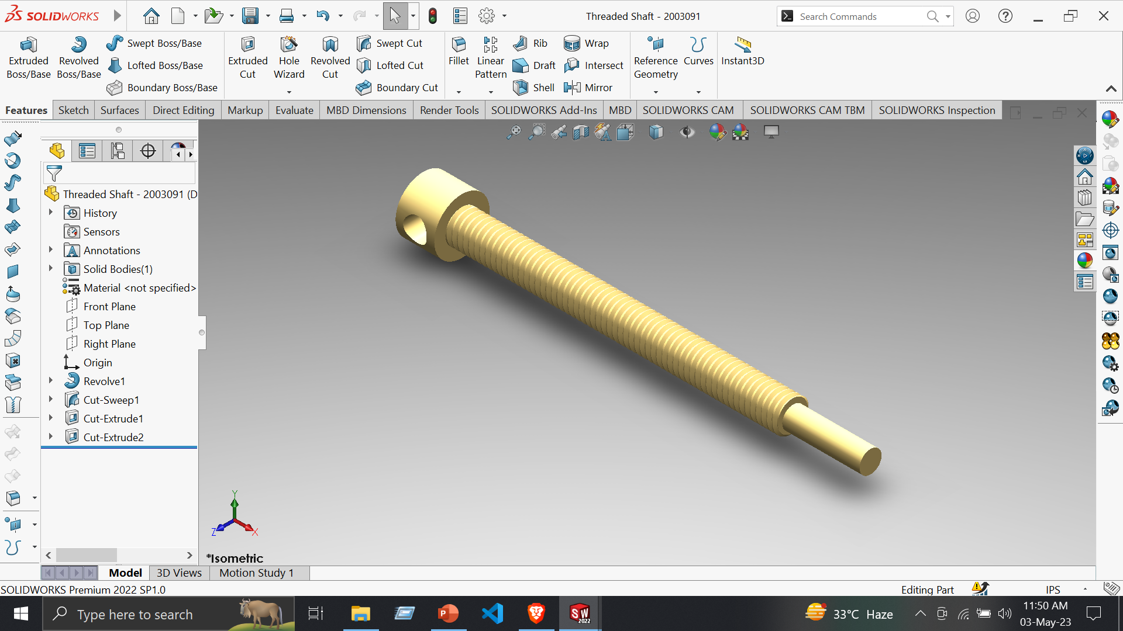
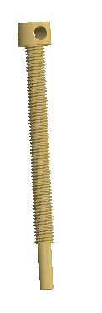
7. Threaded Shaft
Features:
Extruded Boss/Base
Revolved Boss/Base
Swept Cut
Extruded Cut
Tools:
Line
Centerline
Circle
Covert Entities
Smart Dimension

Slide 8
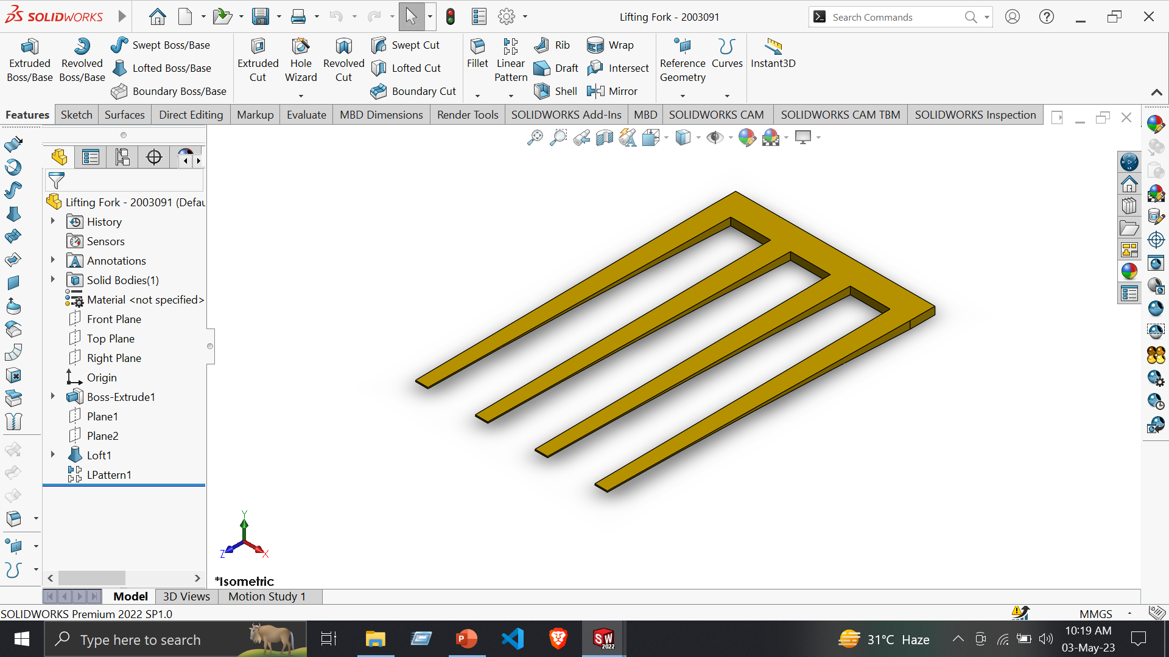
8. Lifting Fork
Features:
Extruded Boss/Base
Reference Geometry -> Plane
Lofted Boss/Base
Linear Pattern
Tools:
Line
Corner Rectangle
Smart Dimension
Display/Delete Relations -> Add Relation

Slide 9
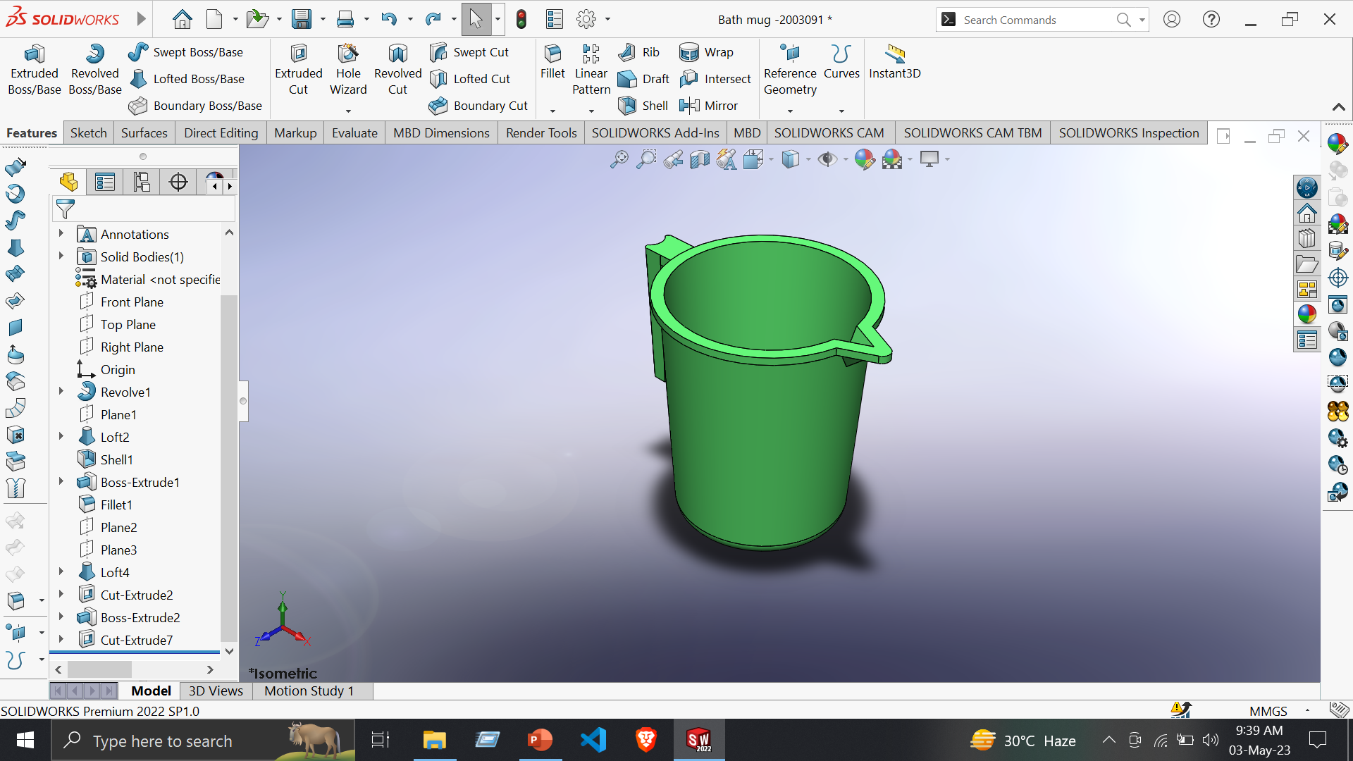
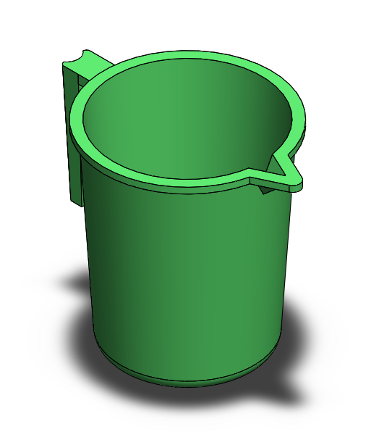
9. Bath Mug
Features:
Extruded Boss/Base
Revolved Boss/Base
Lofted Boss/Base
Extruded Cut
Fillet
Shell
Reference Geometry -> plane
Tools:
Line
Centerline
Circle
Center Rectangle
Spline
Covert Entities
Trim Entities
Point
Smart Dimension

Slide 10
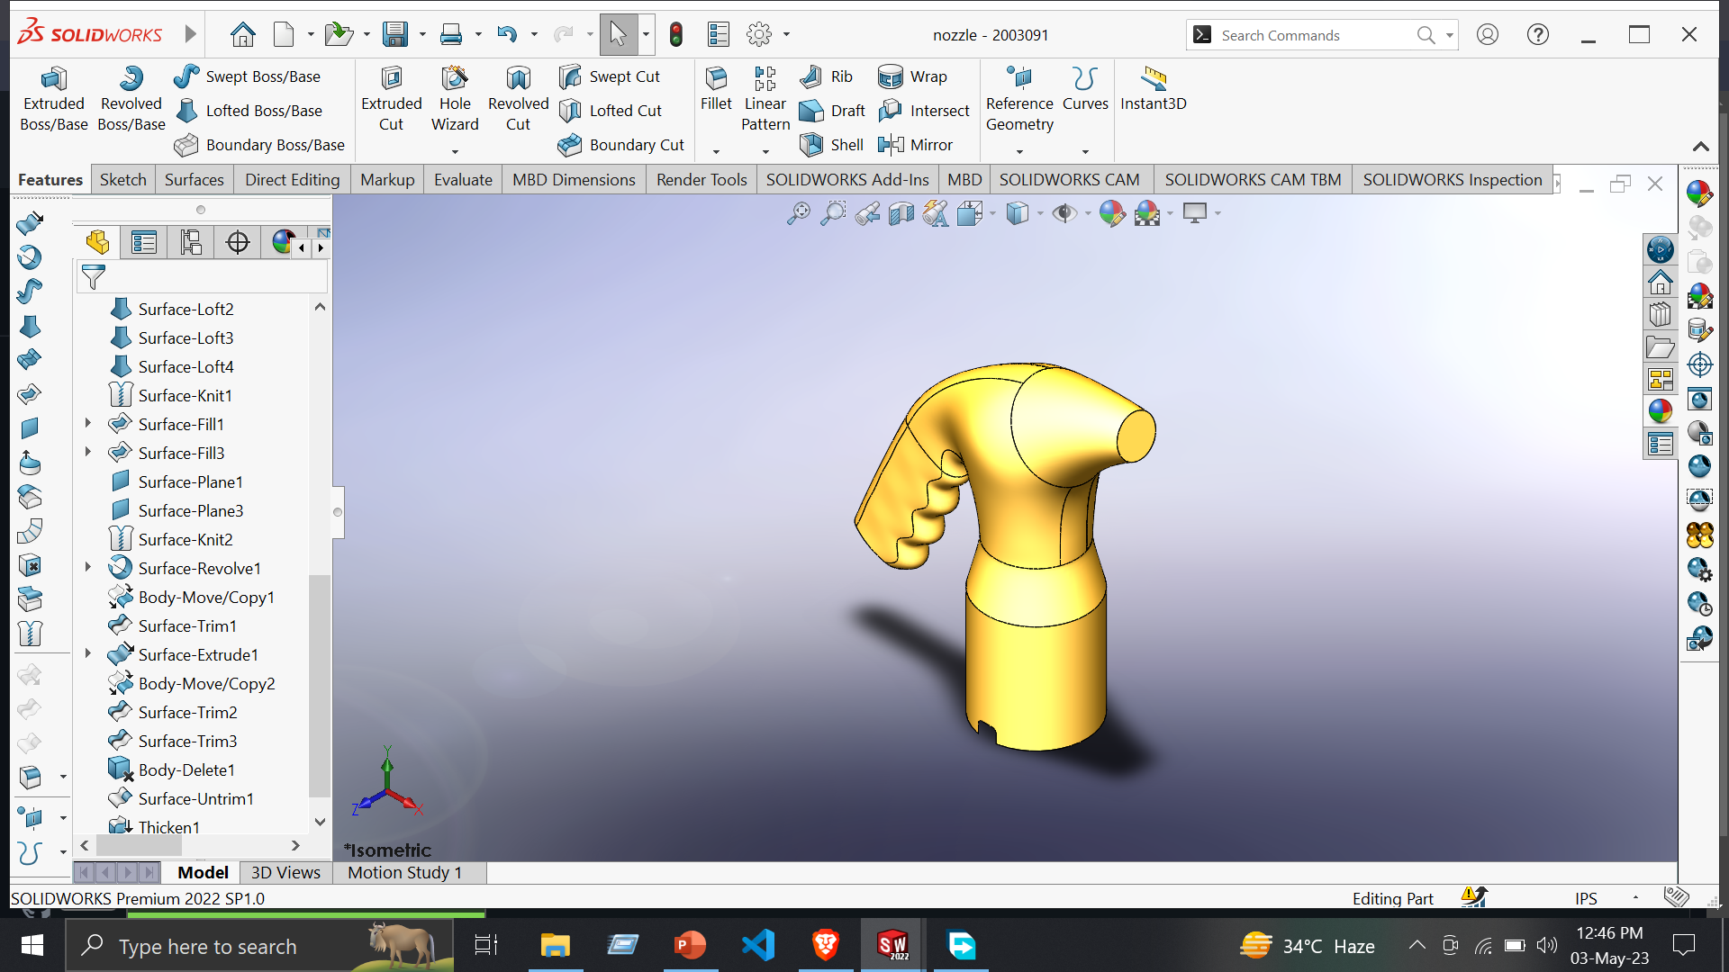
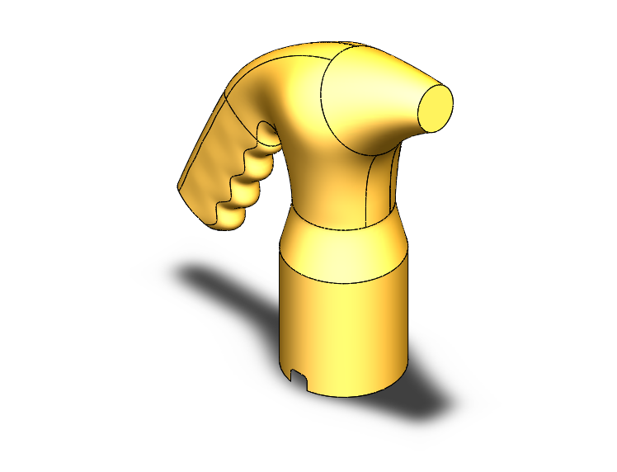
10. Nozzle
Features:
Curves -> Split Line
Surfaces:
Lofted Surface
Swept Surface
Filled Surface
Planer Surface
Trim surface
Knit Surface
Thicken
Direct Editing:
Move/Copy Bodies

Slide 11
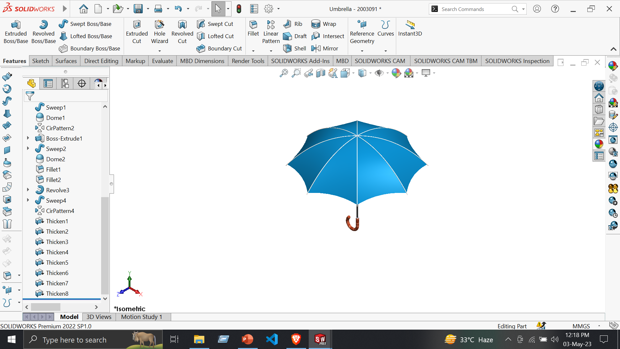
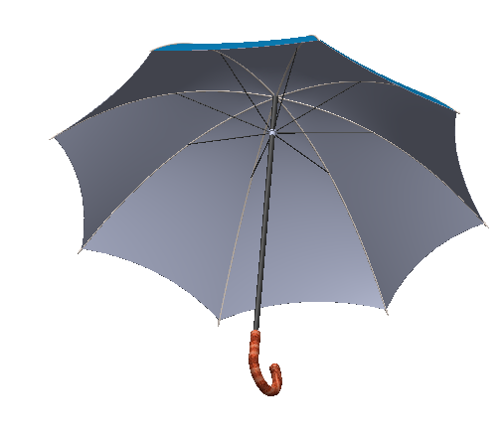
11. Umbrella
Features:
Extruded Boss/Base
Revolved Boss/Base
Swept Boss/Base
Reference Geometry -> Plane
Tools:
Line
Centerline
Circle
3 point Arc
Smart Dimension

Slide 12
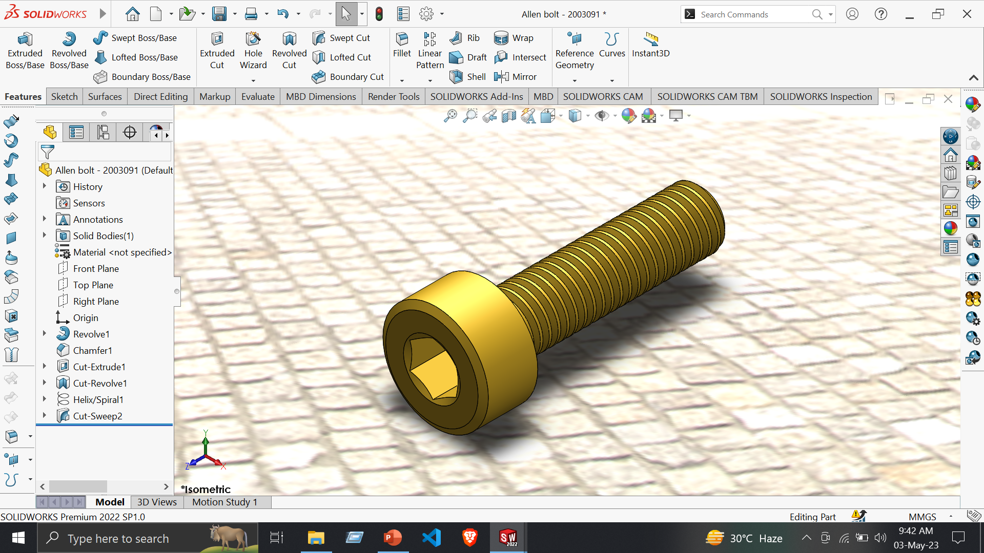
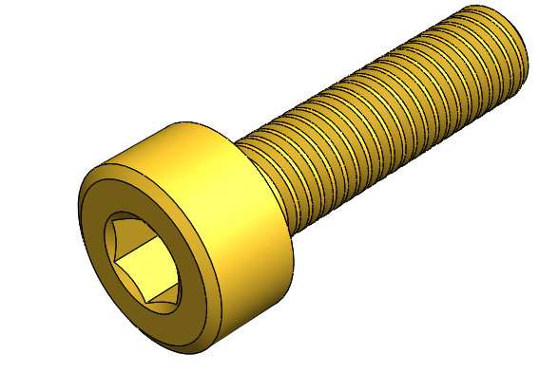
12. Allen Bolt
Features:
Revolved Boss/Base
Extruded Cut
Revolved Cut
Swept Cut
Chamfer
Curves -> Helix and Spiral
Tools:
Line
Circle
Polygon
Centerline
Smart Dimension

